Slide 1

Week 06 Research Design Formulation
Masters of Information Systems & Technology
MIS 6220 RESEARCH METHODS
_{BY}
Prof. Jimmy K.N.Macharia,
Associate Professor of Information Systems &Technology, and
Dean, School of Science & Technology,
_{kmacharia@usiu.ac.ke}

Slide 2
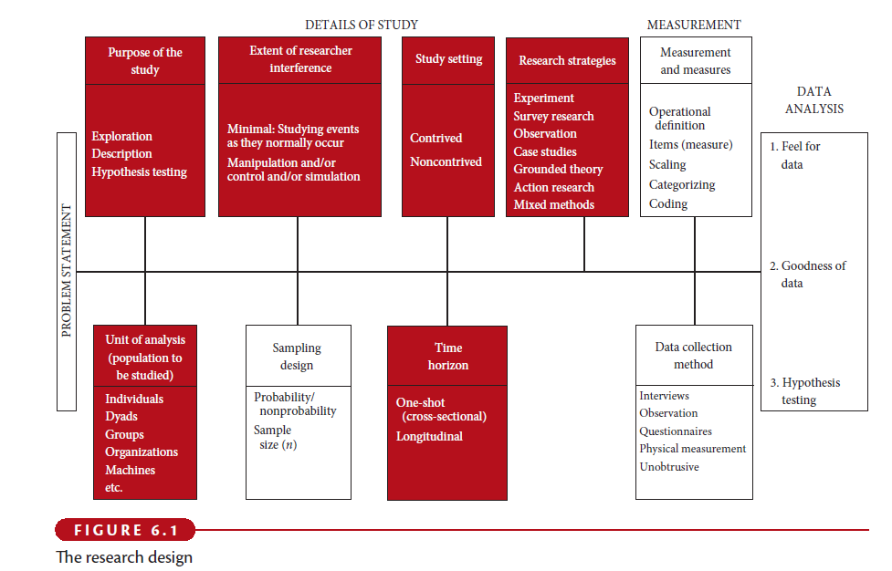
Research Design

Slide 3
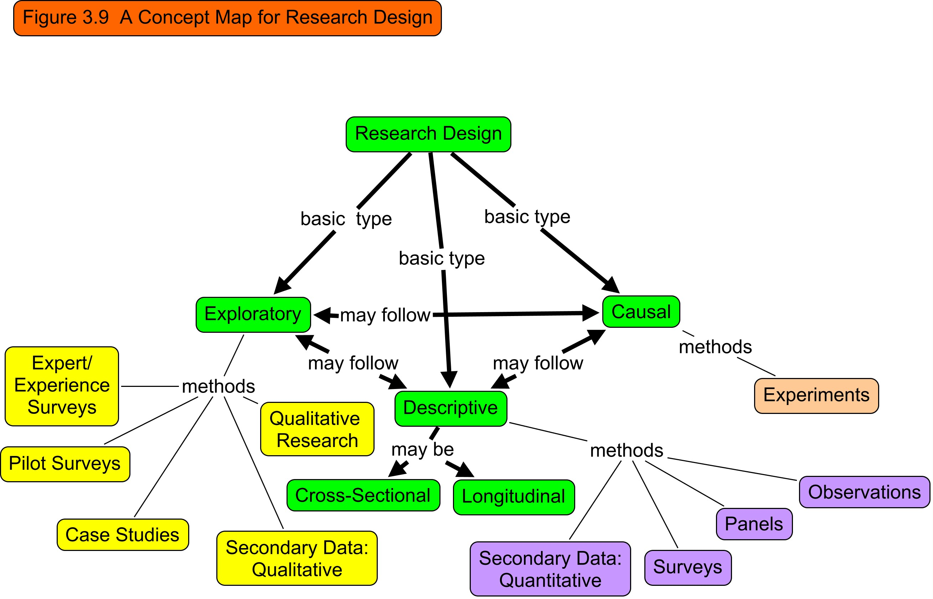

Slide 4

1. Category according to Purpose of the Study
Exploratory
Descriptive
Causal

Slide 5
1.1a Purpose of the Study:Exploratory study
Exploratory study:
is undertaken when not much is known about the situation at hand, or no information is available on how similar problems or research issues have been solved in the past.
Example:
A service provider wants to know why his customers are switching to other service providers?

Slide 6
1.1b: Purpose of the Study: Descriptive study
Descriptive study:
is undertaken in order to ascertain and be able to describe the characteristics of the variables of interest in a situation.
Example:
A bank manager wants to have a profile of the individuals who have loan payments outstanding for 6 months and more. It would include details of their average age, earnings, nature of occupation, full-time/part-time employment status, and the like. This might help him to elicit further information or decide right away on the types of individuals who should be made ineligible for loans in the future.

Slide 7
1.1c Purpose of the Study:Causal study
Causal study:
Delineating one or more factors that are causing the problem.
Example:
A marketing manager wants to know if the sales of the company will increase if he increases the advertising budget.

Slide 8
1.2-Extent of Researcher Interference
Minimal interference
Moderate interference
Excessive interference

Slide 9
1.3- Study Setting
Contrived:
artificial setting
Non-contrived:
the natural environment where work proceeds normally

Slide 10
1.4- Research Strategies
Experiments
Survey Research
Observation
Case studies
Grounded theory
Action research
Mixed Methods

Slide 11
1.5 - Population to be studied
Unit of analysis:
Individuals
Dyads
Groups
Organizations
Cultures

Slide 12
1.6- Time Horizon
Cross-sectional studies
Snapshot of constructs at a single point in time
Use of representative sample
Multiple cross-sectional studies
Constructs measured at multiple points in time
Use of different sample
Longitudinal studies
Constructs measured at multiple points in time
Use of same sample = a true panel

Slide 13
1.7- Research Design: Definition
A research design is a framework or blueprint for conducting the marketing research project.
It details the procedures necessary for obtaining the information needed to structure or solve marketing research problems.

Slide 14
1.8- Components of a Research Design
Define the information needed (Chapter 2)
Design the exploratory, descriptive, and/or causal phases of the research (Chapters 3 - 8)
Specify the measurement and scaling procedures (Chapters 9 and 10)
Construct and pretest a questionnaire (interviewing form) or an appropriate form for data collection (Chapter 11)
Specify the sampling process and sample size (Chapters 12 and 13)
Develop a plan of data analysis (Chapter 15)

Slide 15
Table 3.2
A Comparison of Basic Research Designs
 | Exploratory | Descriptive | Causal
Objective: | Discovery of ideas and insights. | Describe market characteristics or functions. | Determine cause and effect relationships.
Character-istics: | Flexible. Versatile. Often the front end of total research design. | Marked by the prior formulation of specific hypotheses. Preplanned and structured design. | Manipulation of one or more independent variables. Control of other mediating variables.

Slide 16
Table 3.2 (Cont.)
A Comparison of Basic Research Designs
 | Exploratory | Descriptive | Causal
Method: | Expert surveys. Pilot surveys. Case studies. Secondary data (qualitative). Qualitative Research. | Secondary data (quantitative). Surveys. Panels. Observational and other data. | Experiments.

Slide 17
2.1 Uses of Exploratory Research
Formulate a problem or define a problem more precisely
Identify alternative courses of action
Develop hypotheses
Isolate key variables and relationships for further examination
Gain insights for developing an approach to the problem
Establish priorities for further research

Slide 18
2.1a -Methods of Exploratory Research
Survey of experts (discussed in Chapter 2)
Pilot surveys (discussed in Chapter 2)
Secondary data analyzed in a qualitative way (discussed in Chapter 4)
Qualitative research (discussed in Chapter 5)

Slide 19
2.2-Use of Descriptive Research
To describe the characteristics of relevant groups, such as consumers, salespeople, organizations, or market areas
To estimate the percentage of units in a specified population exhibiting a certain behavior
To determine the perceptions of product characteristics
To determine the degree to which marketing variables are associated
To make specific predictions

Slide 20
2.2a- Methods of Descriptive Research
Secondary data analyzed in a quantitative as opposed to a qualitative manner (discussed in Chapters 4 and 5)
Surveys (Chapter 7)
Panels (Chapters 5 and 7)
Observational and other data (Chapter 7)

Slide 21
2.2b- Figure 3.5. Major Types of Descriptive Studies
Descriptive
Studies
Sales Studies
Consumer Perception
And Behavior Studies
Image
Product Usage
Advertising
Pricing
Market
Characteristic
Studies
Distribution
Competitive
Analysis
Market Potential
Market Share
Sales Analysis

Slide 22
2.2c- Cross-sectional and Longitudinal Designs
A cross-sectional design
involves the collection of information from any given sample of population elements only once.
In a longitudinal design,
a fixed sample (or samples) of population elements is measured repeatedly on the same variables.
A longitudinal design
differs from a cross-sectional design in that the sample or samples remain the same over time.

Slide 23
Figure 3.6 Cross Sectional vs. Longitudinal Designs
2.2d- Figure 3.6. Cross-Sectional vs. Longitudinal Designs
Sample Surveyed at T₁
Cross- Sectional Design
Same Sample also Surveyed at T₂
Sample Surveyed at T₁
Longitudinal Design
Time
T₁
T₂

Slide 24
2.2e- Table 3.3
Relative Advantages and Disadvantages of Longitudinal and
Cross-Sectional Designs
Evaluation Criteria | Cross-Sectional Design | Longitudinal Design
Detecting change | - | +
Large amount of data collection | - | +
Accuracy | - | +
Representative sampling | + | -
Response bias | + | -
Note: A + indicates a relative advantage over the other design whereas
a - indicates a relative disadvantage.

Slide 25
2.3 Uses of Casual Research
To understand which variables are the cause (independent variables) and which variables are the effect (dependent variables) of a phenomenon
To determine the nature of the relationship between the causal variables and the effect to be predicted
METHOD: Experiments

Slide 26
2.3b- Figure 3.7. Some Alternative Research Designs
Exploratory
Research
Secondary Data Analysis
Focus Groups
Conclusive Research
Descriptive/Causal
(a)
Conclusive Research
Descriptive/Causal
(b)
Exploratory Research
Secondary Data Analysis
Focus Groups
Conclusive Research
Descriptive/Causal
(c)

Slide 27
3. Summary: Figure 3.8. Tasks Involved In a Research Design
Define the Information Needed
Design the Exploratory, Descriptive, and/or Causal Phases of the Research
Specify the Measurement and Scaling Procedures
Construct a Questionnaire
Specify the Sampling Process and the Sample Size
Develop a Plan of Data Analysis

Slide 28


